Slide 1
EMTH403
Mathematical Foundation for Computer Science

Slide 2
Lecture Outcomes
understand what Spanning Trees
understand what is Kruskal’s Algorithm.

Slide 3
Spanning Trees
A spanning tree of a graph is just a subgraph that contains all the vertices and is a tree.
A graph may have many spanning trees.
Graph A
Some Spanning Trees from Graph A
or
or
or

Slide 4
Spanning Trees
Complete Graph
All 16 of its Spanning Trees

Slide 5
Minimum Spanning Trees
The Minimum Spanning Tree for a given graph is the Spanning Tree of minimum cost for that graph.
Complete Graph
Minimum Spanning Tree
7
2
2
5
3
3
4
1
1

Slide 6
Spanning Trees
Central office

Slide 7
Spanning Trees
Central office
Expensive!

Slide 8
Spanning Trees
Central office
Minimize the total length of wire connecting the customers

Slide 9
Algorithms for Obtaining the Minimum Spanning Tree
Kruskal's Algorithm
Prim's Algorithm

Slide 10
Spanning Trees
There are two basic algorithms for finding minimum-cost spanning trees, and both are greedy algorithms
Kruskal’s algorithm: Start with no nodes or edges in the spanning tree, and repeatedly add the cheapest edge that does not create a cycle
  Here, we consider the spanning tree to consist of edges only

Slide 11
Spanning Trees
Prim’s algorithm: Start with any one node in the spanning tree, and repeatedly add the cheapest edge, and the node it leads to, for which the node is not already in the spanning tree.
  Here, we consider the spanning tree to consist of both nodes and edges

Slide 12
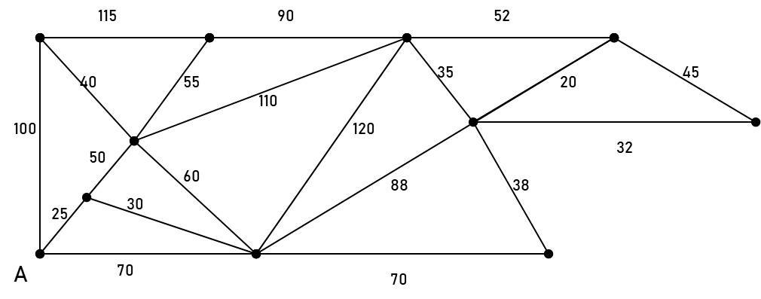
Kruskal’s Algorithm
Find the minimum spanning tree using Kruskal’s Algorithm.
List the edges in increasing order:
20, 25, 30, 32, 35, 38, 40, 45, 50, 52, 55, 60, 70, 70, 88, 90, 100, 110, 115, 120

Slide 13
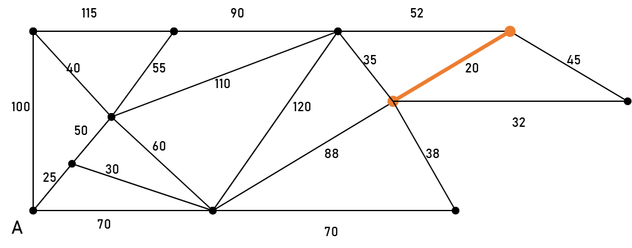
Spanning Trees
Starting from the left, add the edge to the tree if it does not close up a circuit with the edges chosen up to that point: 20, 25, 30, 32, 35, 38, 40, 45, 50, 52, 55, 60, 70, 70, 88, 90, 100, 110, 115, 120

Slide 14
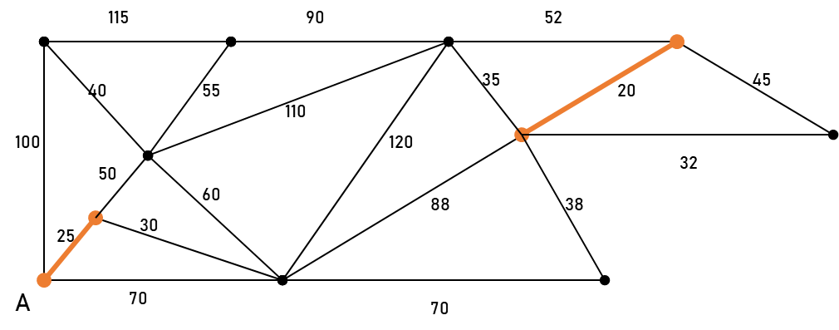
Kruskal’s Algorithm
Add the next edge in the list to the tree if it does not close up a circuit with the edges chosen up to that point: 20, 25, 30, 32, 35, 38, 40, 45, 50, 52, 55, 60, 70, 70, 88, 90, 100, 110, 115, 120

Slide 15
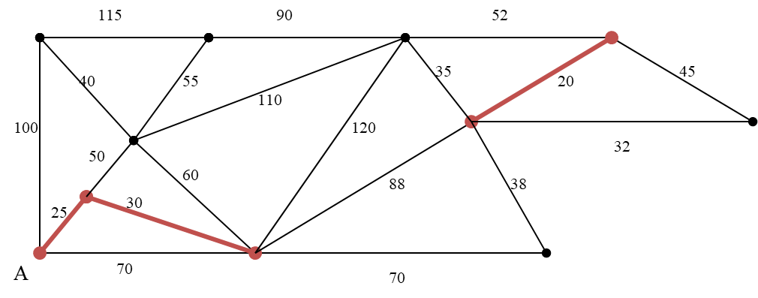
Kruskal’s Algorithm
Add the next edge in the list to the tree if it does not close up a circuit with the edges chosen up to that point: 20, 25, 30, 32, 35, 38, 40, 45, 50, 52, 55, 60, 70, 70, 88, 90, 100, 110, 115, 120

Slide 16
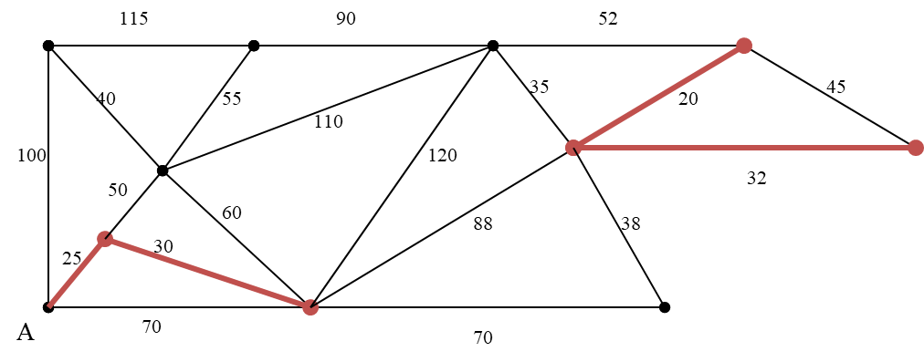
Kruskal’s Algorithm
Add the next edge in the list to the tree if it does not close up a circuit with the edges chosen up to that point: 20, 25, 30, 32, 35, 38, 40, 45, 50, 52, 55, 60, 70, 70, 88, 90, 100, 110, 115, 120

Slide 17
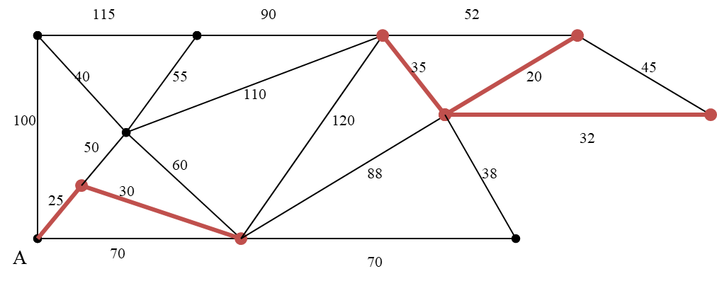
Kruskal’s Algorithm
Add the next edge in the list to the tree if it does not close up a circuit with the edges chosen up to that point: 20, 25, 30, 32, 35, 38, 40, 45, 50, 52, 55, 60, 70, 70, 88, 90, 100, 110, 115, 120

Slide 18
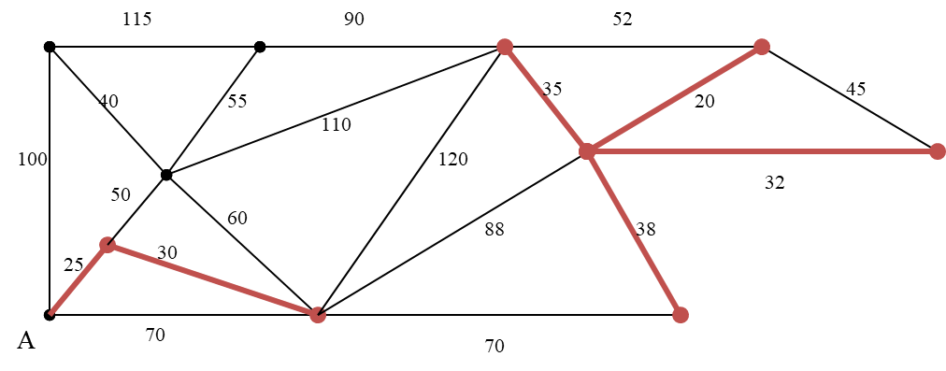
Kruskal’s Algorithm
Add the next edge in the list to the tree if it does not close up a circuit with the edges chosen up to that point: 20, 25, 30, 32, 35, 38, 40, 45, 50, 52, 55, 60, 70, 70, 88, 90, 100, 110, 115, 120

Slide 19
Kruskal’s Algorithm
Add the next edge in the list to the tree if it does not close up a circuit with the edges chosen up to that point: 20, 25, 30, 32, 35, 38, 40, 45, 50, 52, 55, 60, 70, 70, 88, 90, 100, 110, 115, 120

Slide 20
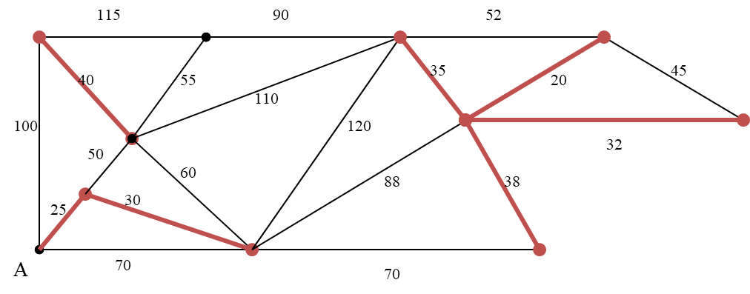
Kruskal’s Algorithm
Add the next edge in the list to the tree if it does not close up a circuit with the edges chosen up to that point: 20, 25, 30, 32, 35, 38, 40, 45, 50, 52, 55, 60, 70, 70, 88, 90, 100, 110, 115, 120

Slide 21
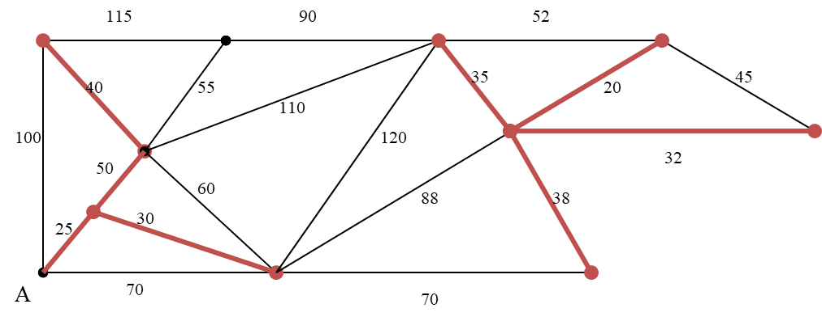
Kruskal’s Algorithm
Add the next edge in the list to the tree if it does not close up a circuit with the edges chosen up to that point. Notice that the edge of weight 45 would close a circuit, so we skip it.
20, 25, 30, 32, 35, 38, 40, 45, 50, 52, 55, 60, 70, 70, 88, 90, 100, 110, 115, 120

Slide 22
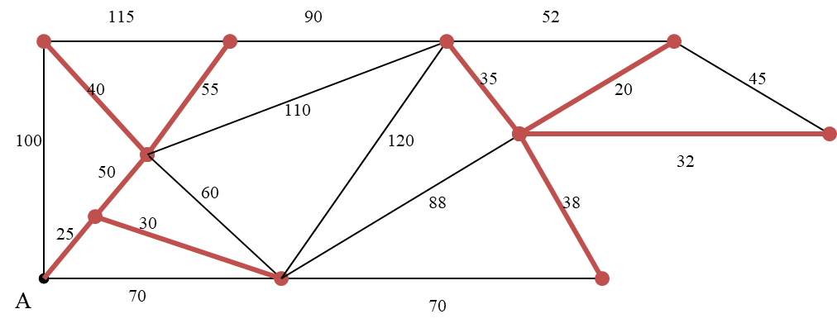
Kruskal’s Algorithm
Add the next edge in the list to the tree if it does not close up a circuit with the edges chosen up to that point:
20, 25, 30, 32, 35, 38, 40, 45, 50, 52, 55, 60, 70, 70, 88, 90, 100, 110, 115, 120

Slide 23
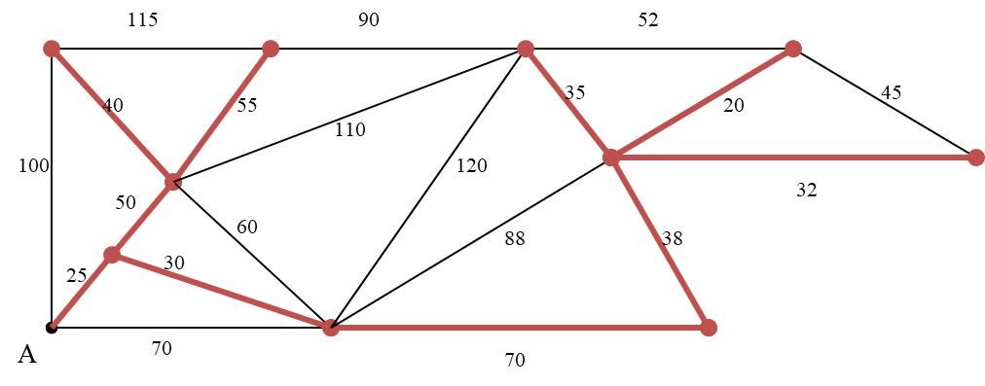
Kruskal’s Algorithm
Add the next edge in the list to the tree if it does not close up a circuit with the edges chosen up to that point:
20, 25, 30, 32, 35, 38, 40, 45, 50, 52, 55, 60, 70, 70, 88, 90, 100, 110, 115, 120

Slide 24
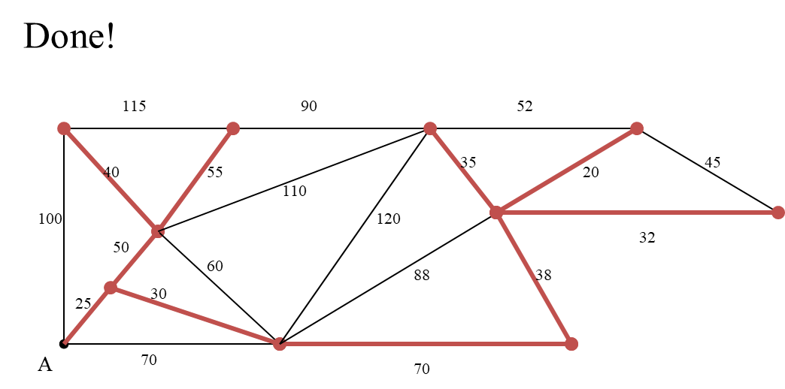
Kruskal’s Algorithm
The tree contains every vertex, so it is a spanning tree. The total weight is 395

Slide 25
Kruskal’s Algorithm
Make a disjoint set for each vertex
1
2
1
2
3
{1}{2}{3}{4}{5}{6}{7}
6
5
4
4
6
3
8
4
5
6
7
4
3
7

Slide 26
Kruskal’s Algorithm
Sort edges by weight
1
2
1
2
3
1: {1,2}
{1}{2}{3}{4}{5}{6}{7}
2: {2,3}
6
5
4
4
6
3: {4,5}
3
8
3: {6,7}
4
5
6
4: {1,4}
4: {2,5}
7
4
3
4: {4,7}
5: {3,5}
7

Slide 27
Kruskal’s Algorithm
Add first edge to X if no cycle created
1
2
1
2
3
1: {1,2}
{1}{2}{3}{4}{5}{6}{7}
2: {2,3}
6
5
4
4
6
3: {4,5}
3
8
3: {6,7}
4
5
6
4: {1,4}
4: {2,5}
7
4
3
4: {4,7}
5: {3,5}
7

Slide 28
Kruskal’s Algorithm
Merge vertices in added edges
1
2
1
2
3
1: {1,2}
{1,2}{3}{4}{5}{6}{7}
2: {2,3}
6
5
4
4
6
3: {4,5}
3
8
3: {6,7}
4
5
6
4: {1,4}
4: {2,5}
7
4
3
4: {4,7}
5: {3,5}
7

Slide 29
Kruskal’s Algorithm
Process each edge in order
1
2
1
2
3
1: {1,2}
{1,2}{3}{4}{5}{6}{7}
2: {2,3}
{1,2,3}{4}{5}{6}{7}
6
5
4
4
6
3: {4,5}
3
8
3: {6,7}
4
5
6
4: {1,4}
4: {2,5}
7
4
3
4: {4,7}
5: {3,5}
7

Slide 30
Kruskal’s Algorithm
1
2
1
2
3
1: {1,2}
{1,2}{3}{4}{5}{6}{7}
2: {2,3}
{1,2,3}{4}{5}{6}{7}
6
5
4
4
6
3: {4,5}
{1,2,3}{4,5}{6}{7}
3
8
3: {6,7}
4
5
6
4: {1,4}
4: {2,5}
7
4
3
4: {4,7}
5: {3,5}
7
Note that each set is a connected component of G

Slide 31
Kruskal’s Algorithm
1
2
1
2
3
1: {1,2}
{1,2}{3}{4}{5}{6}{7}
2: {2,3}
{1,2,3}{4}{5}{6}{7}
6
5
4
4
6
3: {4,5}
{1,2,3}{4,5}{6}{7}
3
8
3: {6,7}
{1,2,3}{4,5}{6,7}
4
5
6
4: {1,4}
4: {2,5}
7
4
3
4: {4,7}
5: {3,5}
7

Slide 32
Kruskal’s Algorithm
1
2
1
2
3
1: {1,2}
{1,2}{3}{4}{5}{6}{7}
2: {2,3}
{1,2,3}{4}{5}{6}{7}
6
5
4
4
6
3: {4,5}
{1,2,3}{4,5}{6}{7}
3
8
3: {6,7}
{1,2,3}{4,5}{6,7}
4
5
6
4: {1,4}
{1,2,3,4,5}{6,7}
4: {2,5}
7
4
3
4: {4,7}
5: {3,5}
7

Slide 33
Kruskal’s Algorithm
Must join separate components
1
2
1
2
3
1: {1,2}
{1,2}{3}{4}{5}{6}{7}
2: {2,3}
{1,2,3}{4}{5}{6}{7}
6
5
4
4
6
3: {4,5}
{1,2,3}{4,5}{6}{7}
3
8
3: {6,7}
{1,2,3}{4,5}{6,7}
4
5
6
4: {1,4}
{1,2,3,4,5}{6,7}
4: {2,5}
rejected
7
4
3
4: {4,7}
5: {3,5}
7

Slide 34
Kruskal’s Algorithm
Done when all vertices in one set
Then they are all connected
Exactly |V| - 1 edges
1
2
1
2
3
1: {1,2}
{1,2}{3}{4}{5}{6}{7}
2: {2,3}
{1,2,3}{4}{5}{6}{7}
6
5
4
4
6
3: {4,5}
{1,2,3}{4,5}{6}{7}
3
8
3: {6,7}
{1,2,3}{4,5}{6,7}
4
5
6
4: {1,4}
{1,2,3,4,5}{6,7}
4: {2,5}
rejected
7
4
3
4: {4,7}
{1,2,3,4,5,6,7} done
5: {3,5}
7

